Slide 1

Addressing Phase Noise Issues in FMCW Lidar
Taehwan Kim

Slide 2


FMCW lidar
No tradeoff between peak power vs. resolution like pulsed lidar
Requires longer integration for resolving smaller frequency difference
No need for fast electrical FE
Coherent RX achieves shot-noise limited detection with normal PD
Interference rejection
What are the issues when you try to extend the range, say 100m?
FMCW LIDAR
Tunable Laser
Splitter
Target
LO Path
Beat
Signal
Coupler
Spectrometer

Slide 3
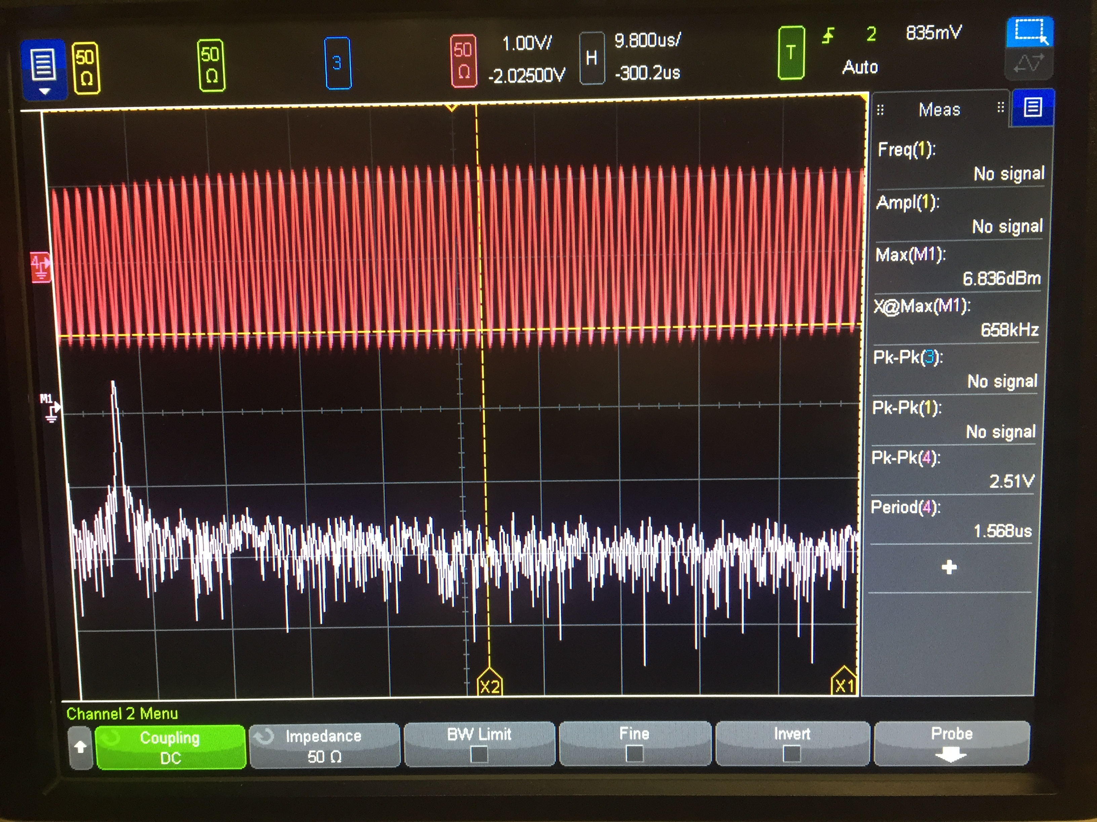
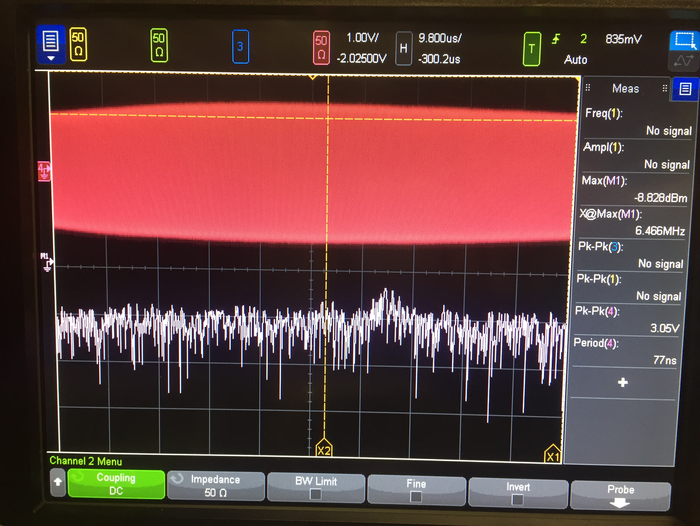
Phase Noise Problem
FMCW LIDAR
Tunable Laser
Splitter
Target
LO Path
20cm
2m
The farther the target is away, the less the phase noise of TX/RX beams are correlated (less coherent)
Even though you have infinite laser power, SNR is limited by the spectral purity of the tunable laser
Beat
Signal
Coupler
Spectrometer

Slide 4
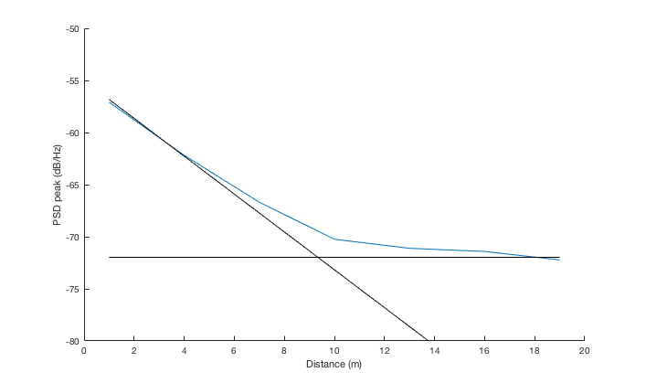
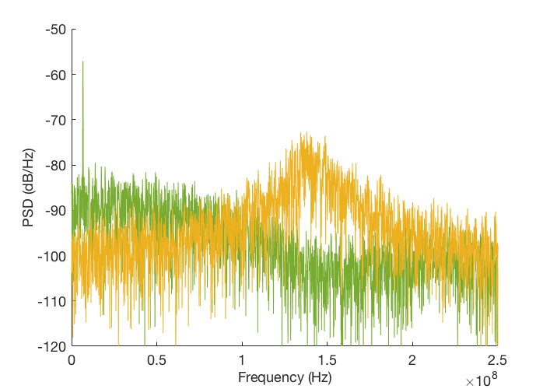
Phase Noise Problem
Photocurrent PSD from theory
Beyond coherence range (𝜏 > 𝜏_{c}), beating signal vanishes; it’s just Lorentzian lineshape + shot noise floor
This is the case for both colored/white frequency noise in the laser
Linewidth: 10MHz
Coherence range: 4.77m
Scan time: 10us
Coherence range
Phase noise pedestal peak
Signal power
1m
20m

Slide 5
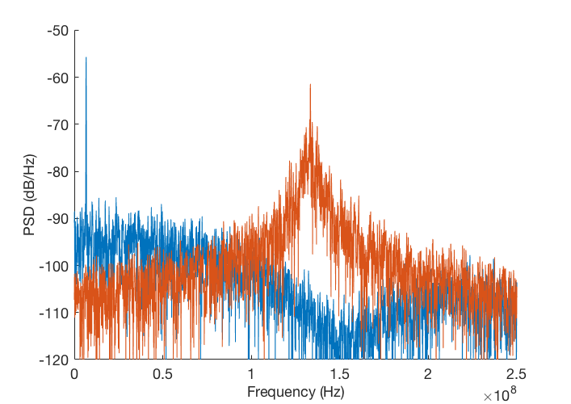
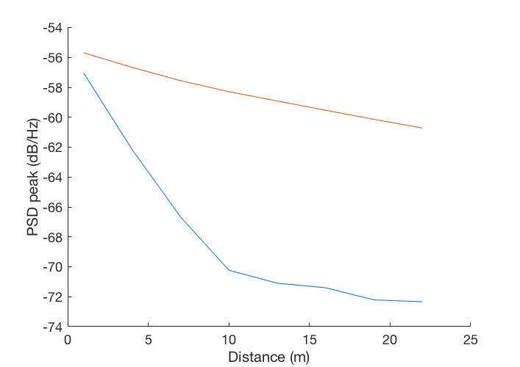
Photocurrent PSD Beyond Coherence Range
Scan time: 10us
1m
Linewidth: 2MHz²/Hz
20m
Linewidth: 10MHz²/Hz
1m
20m

Slide 6
Photocurrent PSD Beyond Coherence Range
Scan time: 10us
1m
Linewidth: 2MHz²/Hz
20m
How can we solve phase noise problem?
By using better spectral estimation algorithm
By improving laser modulation hardware
Linewidth: 10MHz²/Hz
1m
20m

Slide 7
Photocurrent PSD Beyond Coherence Range
Scan time: 10us
1m
Linewidth: 2MHz²/Hz
20m
How can we solve phase noise problem?
By using better spectral estimation algorithm
By improving laser modulation hardware
Linewidth: 10MHz²/Hz
1m
20m

Slide 8
Detection Algorithm
Common belief: targets should always be within the coherence range
Significantly constrains linewidth spec for tunable laser
Long-range Lidar is not targeting for 𝜇m-level accuracy
If we can assume there’s single scatterer, we can fit the PSD estimate to the known shape (Lorentzian + white background) to get better distance estimate than just FFT → peak-finding
Problem of super-resolution!
Given prior:

Slide 9
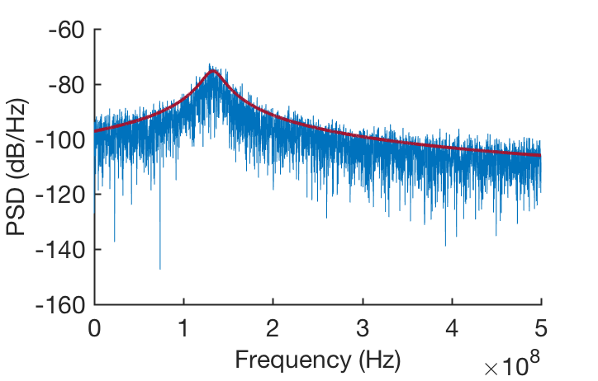
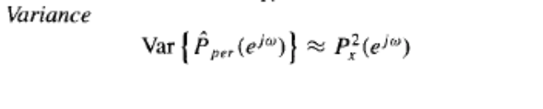
Spectral Estimation Process
Procedure
Estimate PSD from time-domain signal with FFT (periodogram)
Then apply fitting with known Lorentzian prior
Fitting methods
(Nonlinear) least squares estimation (LSE)
Maximum likelihood estimation (MLE)
MLE can be better, as it can take into account the uneven estimation variance of periodogram over frequency bins
For periodogram estimation, variance is bigger for bins with higher power
(just like shot-noise limited photodetectors)

Slide 10
FMCW LIDAR
Tunable Laser
Splitter
Target
LO Path
Beat
Signal
Coupler
Phase noise!
20cm
2m
Spectrometer
Phase
mod.
PD
Integrate
A
Detector algorithm
Improved optical PLL with feedforward noise canceling

Slide 11
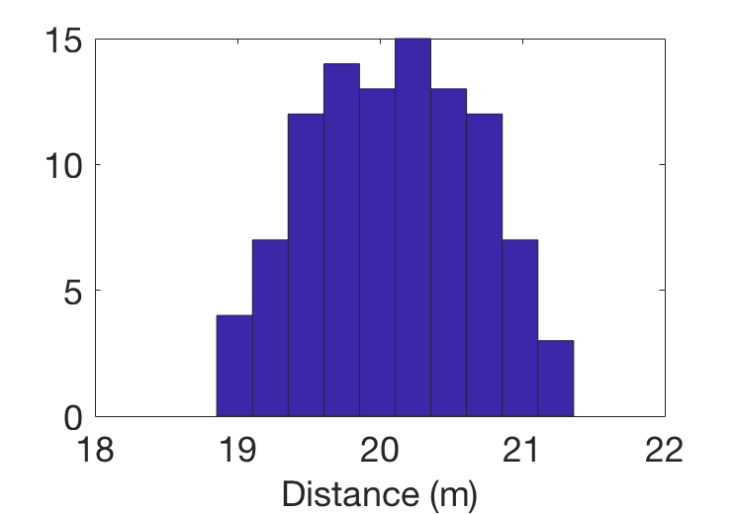
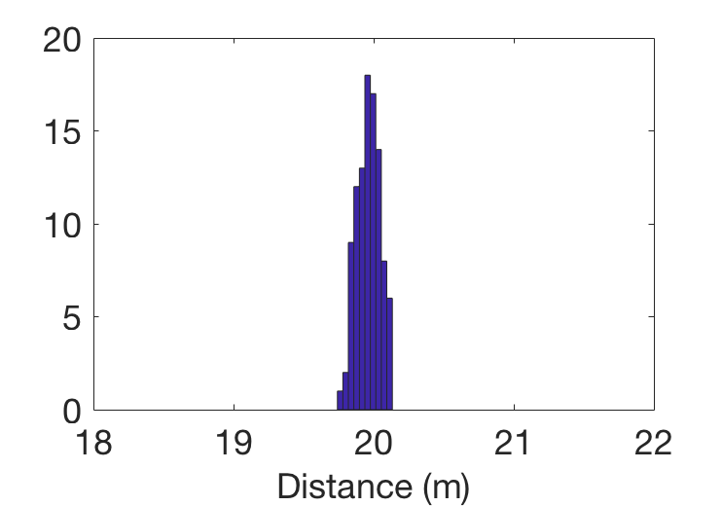
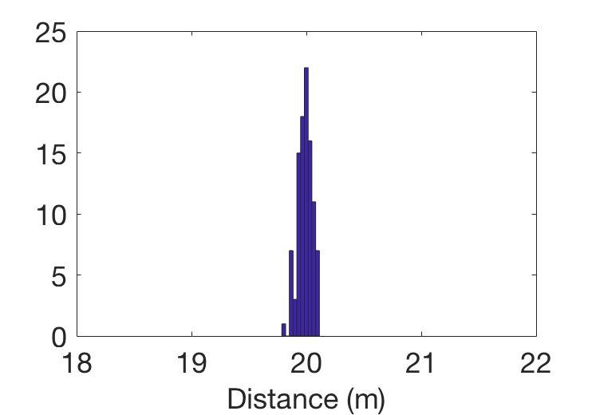
Example
Distance: 20m
Linewidth: 10MHz²/Hz
Chirp bandwidth: 10GHz
Scan time: 10us
Bin-size limited resolution: 1.5cm
100 samples
Zero shot noise
Periodogram + peak-finding
𝜎=58.7cm
LSE
MLE
𝜎=8.2cm
𝜎=6.4cm

Slide 12
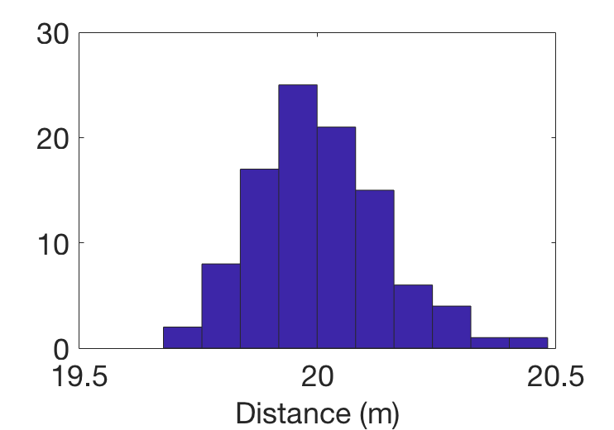
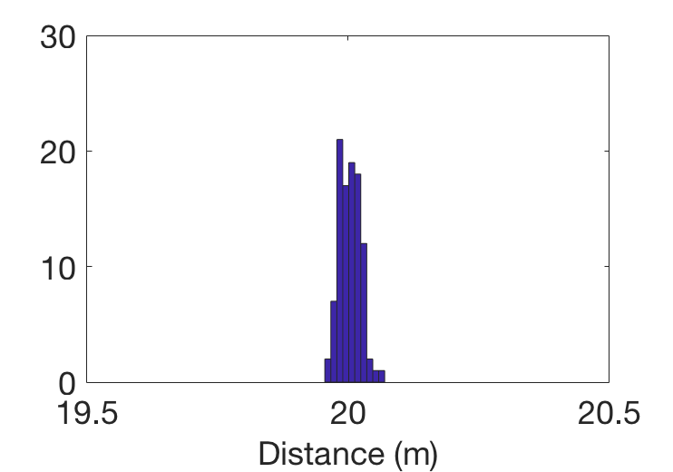
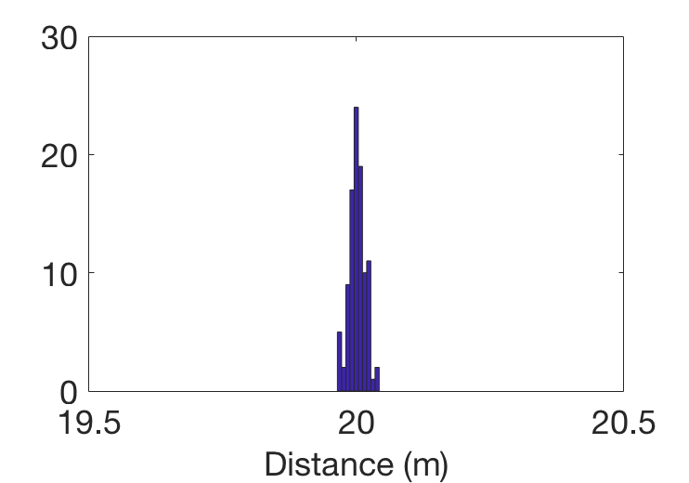
Example
Distance: 20m
Linewidth: 10MHz²/Hz
Chirp bandwidth: 40GHz
Scan time: 10us
Bin-size limited resolution: 0.375cm
100 samples
Zero shot noise
Periodogram + peak-finding
𝜎=13.8cm
LSE
MLE
𝜎=2.03cm
𝜎=1.5cm

Slide 13
End-to-End Model for System Design Guideline
Plugging everything into the end-to-end model, what is the required RX power to achieve desired accuracy (say 10cm)?
Required LO power is determined by the electrical frontend design → need to increase just until the photodetector is shot-noise limited
The performance is no longer sensitive to the distance once it’s in incoherent regime
FMCW LIDAR
Tunable Laser
Splitter
Target
LO Path
Beat
Signal
Coupler
Spectrometer
How much power we need here to hit certain accuracy target?

Slide 14
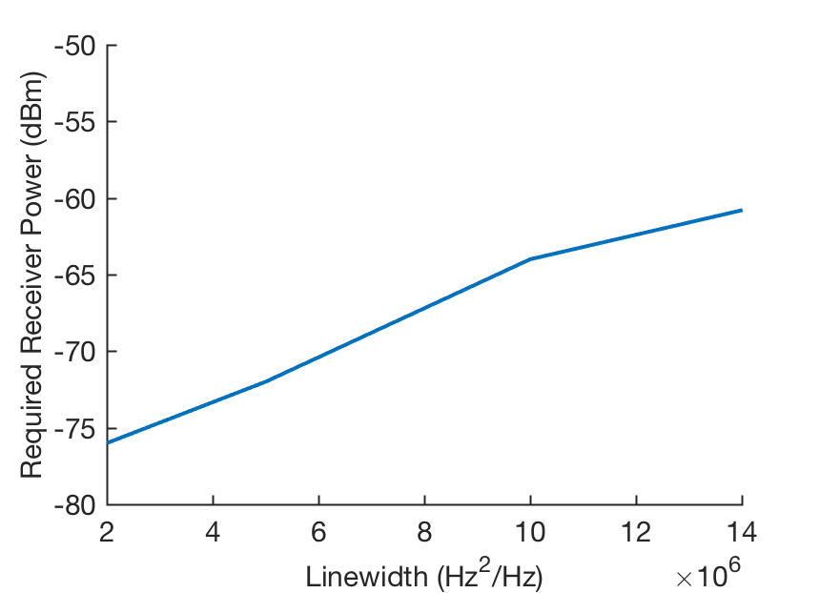
End-to-End Model for System Design Guideline
Takeaway
Actual spectral estimation algorithm has to be included in the system-level specification
For given linewidth, there’s a lower bound for the required RX beam power (so that the Lorentzian is not completely buried by the shot noise floor)
Beyond that lower bound and for target accuracy, required power is inversely proportional to the chirp bandwidth
Chirp bandwidth: 10GHz
Scan time: 10us
R_{PD}: 1A/W
MLE fitting

Slide 15
Photocurrent PSD Beyond Coherence Range
Scan time: 10us
1m
Linewidth: 2MHz²/Hz
20m
How can we solve phase noise problem?
By using better spectral estimation algorithm
By improving laser modulation hardware
Linewidth: 10MHz²/Hz
1m
20m

Slide 16
Feedforward Phase Noise Cancellation
Optical PLL for laser chirp linearization
Can solve chirp nonlinearity problem, but phase noise filtering is limited by the closed-loop bandwidth of the PLL

Slide 17
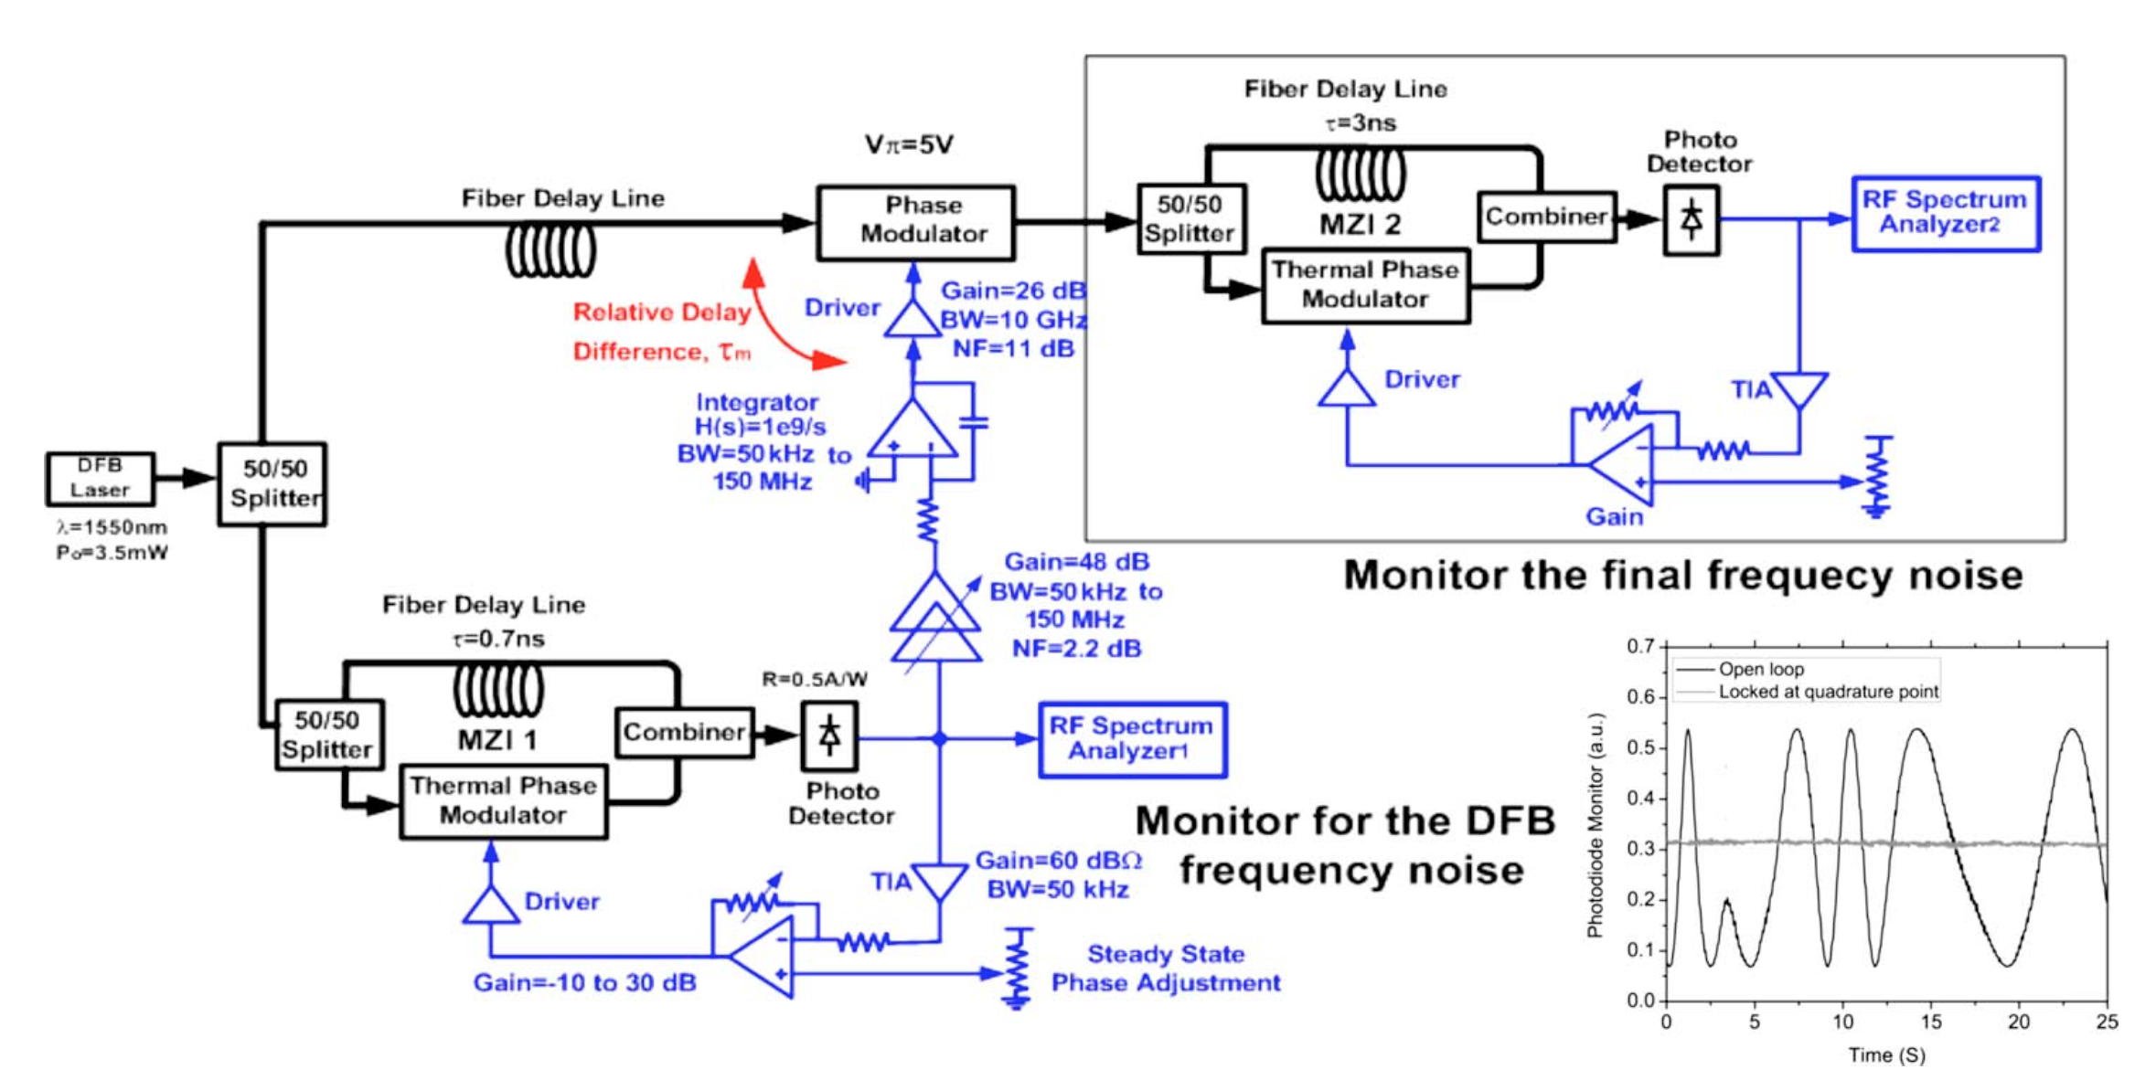
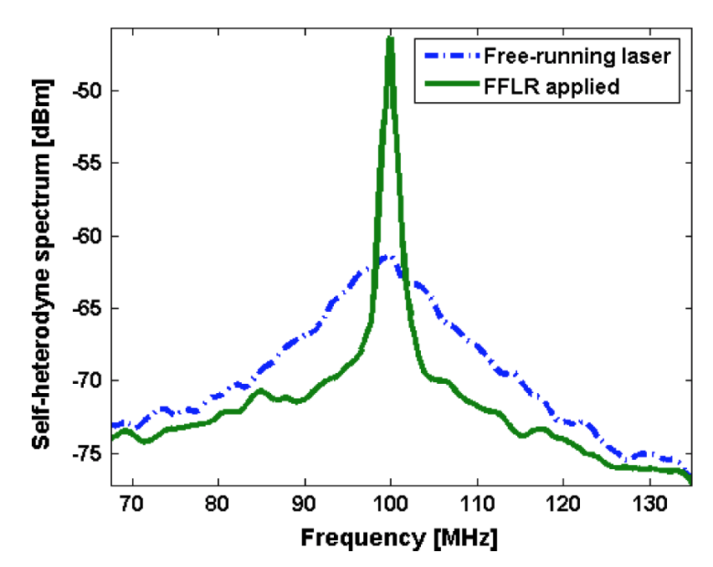
Feedforward Phase Noise Cancellation
Laser phase noise reduction with feedforward cancellation
Use asymmetric MZI to measure the phase noise & actively cancel it using phase modulator
[Aflatouni 2010]

Slide 18
Feedforward Phase Noise Cancellation for FMCW Lidar
Optical PLL already has an interferometer
Since it’s chirped, we just need to down-convert the photocurrent to the DC using an analog mixer
Phase
mod.
Final
laser out
Analog PD for removing phase ramp
PD
Integrate
A

Slide 19
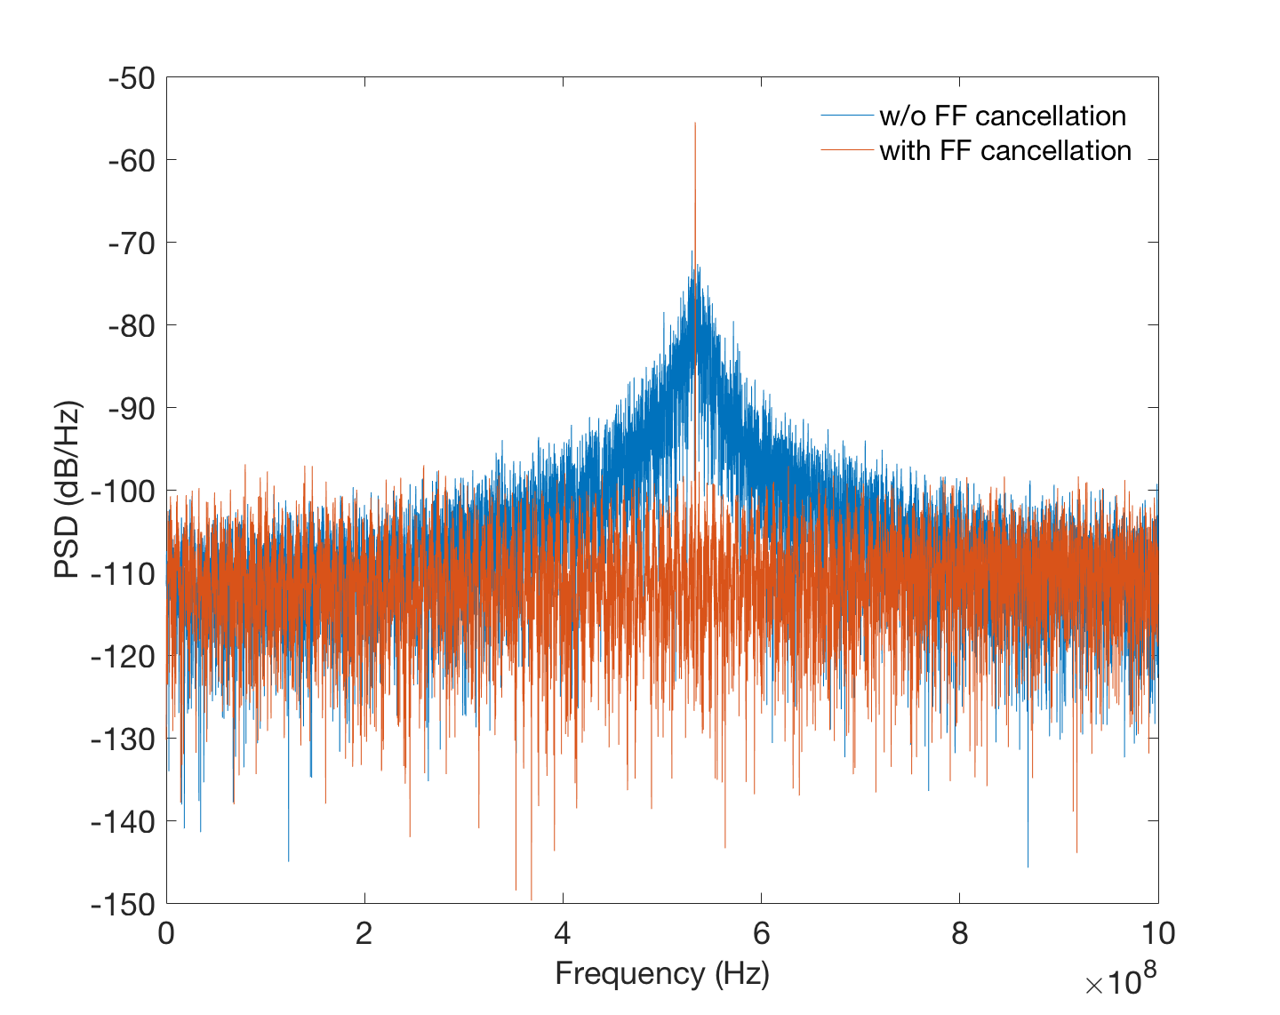
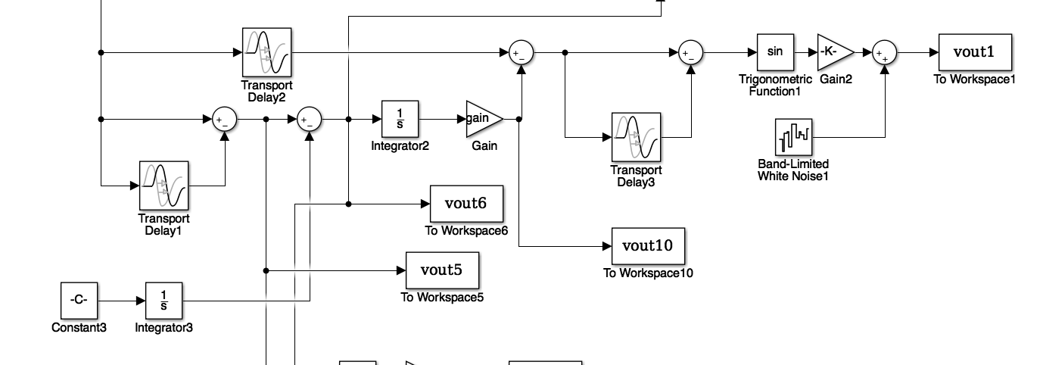
Simulation Result
Distance: 20m
Linewidth: 10MHz²/Hz
Scan time: 10us
Chirp bandwidth: 40GHz
MZI delay difference: 1ns

Slide 20
Implementation Issues
Gain/delay needs to be matched well
Gain of FF path ∝ 𝜏
On-chip 𝜏: a few ns at most
Requires huge gain…
Also, removal of phase ramp using analog mixer can introduce a lot of noise
Phase multiplication before downconverting could help
Phase
mod.
PD
Integrate
A
Final
laser out

Slide 21
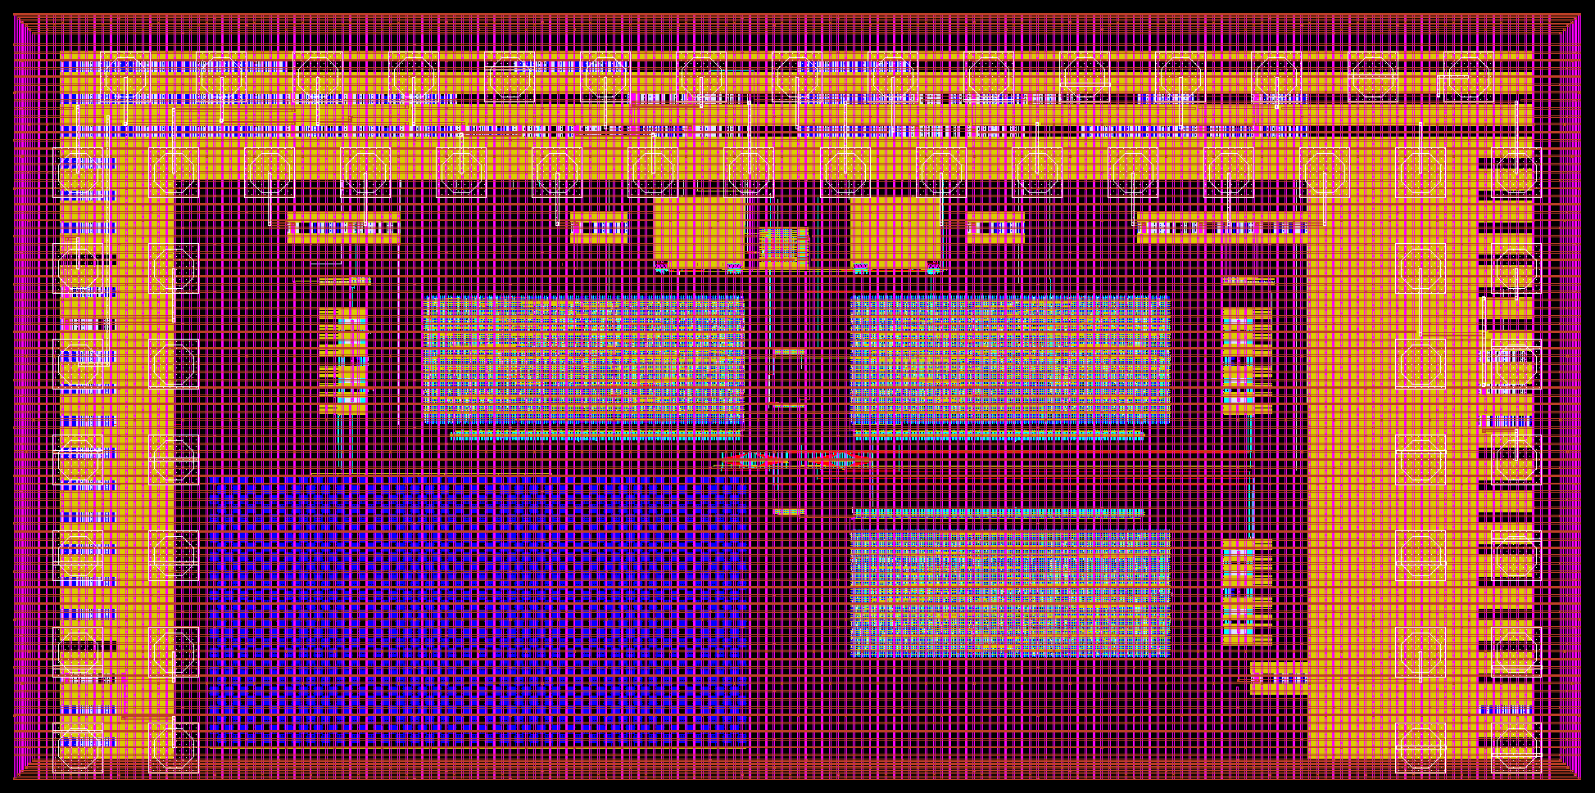
Actual Demonstration Platform
FMCW Lidar prototype chip CMOS: 3x1.5mm, GF45nm SOI process
Similar optical PLL system as Behnam’s but implemented in digital to have more flexibility so that it can be compatible with wider range of laser/photonics

Slide 22

Actual Demonstration Platform
FMCW Lidar prototype chip photonics: CNSE 300mm process
BPD (got 20uApp for 0dBm)
Lidar TX/RX
LO Path
Delay (1.14ns)
9:1 tap

